Slide 1

Class attendance system using face detection
Supervised by: Dr. / Waleed Makram T.a. / Hager Nady
Prepared by: Mohamed Khaled Yousef Abubakr Hussein Hammad Islam Saleh

Slide 2

Content
Problem
Analysis
Solution
Prototype
Software Design
Use case
Sequence diagrams
Class diagram
ERD
Database
Results and Conclusion

Slide 3

Problem
Traditional method (Sheet - Paper)
Waste of time
Incorrect attendance
Causes a lot of disturbance
Takes lot of effort and time
Human error

Slide 4
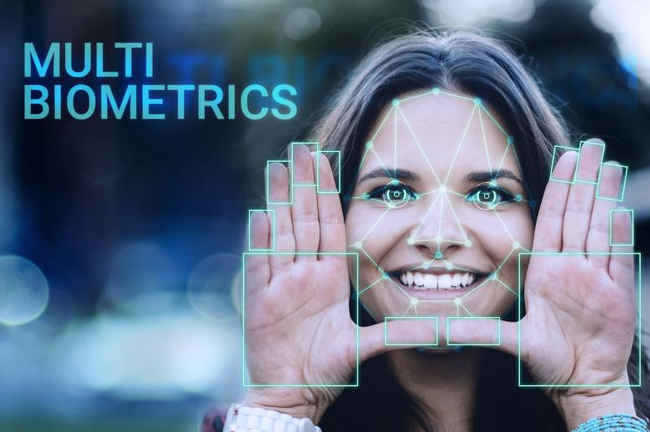
Multimodal biometrics
Analysis the problem
Use one of biometrics for authentication and identification
Biometrics is the science that allows a person to be identified and authenticated based on a set of recognizable and verifiable data, which are unique and specific to them.
Types of biometrics:
Face Recognition.
Fingerprint Recognition.
Iris Recognition.
Hand Recognition.
Voice Recognition.
Signature Recognition.

Slide 5
Face Recognition
WHY ?
WHAT ?
Implementation ?
How works ?
WHY face recognition?
Because while it compare with other biometric options,
It is :
Accurate
Allows for high enrolment and verification rates
Require zero effort from the user

Slide 6
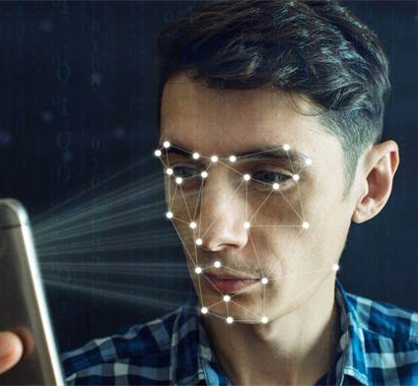
Face Recognition
WHY ?
WHAT ?
Implementation ?
How works ?
WHAT is face recognition?
Face recognition system is a one type of biometric computer application which can identify or verify a person from a digital image by comparing and analyzing patterns.
One of the ways to do this is by comparing selected facial features from the image and facial database
Present facial recognition systems work with face prints and these systems can recognize 80 nodal points on a human face to measure variables on a person’s face, which includes the length and width of the nose, cheekbone shape and the eye socket depth.

Slide 7
Face Recognition
WHY ?
WHAT ?
Implementation ?
How works ?
Implementation of face recognition?
Includes the following three stages
Image Acquisition (Face detection)
Face image classification and decision making (Features extraction)
Computer vision (Face Recognition)

Slide 8
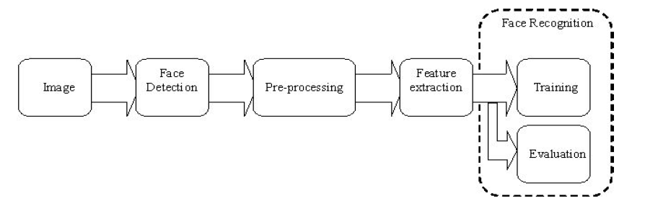
System Architecture Diagram

Slide 9
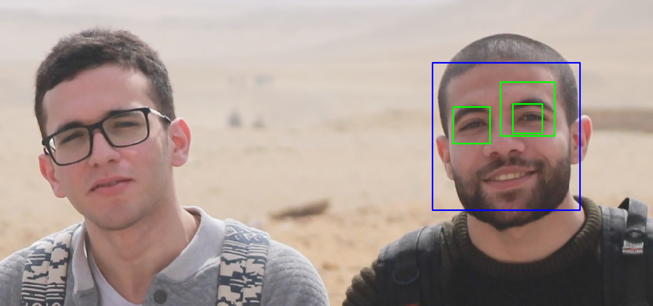
Face Recognition
WHY ?
WHAT ?
Implementation ?
How works ?
1-Image Acquisition (Face detection)
Facial-scan technology can acquire faces from almost any static camera of video system that generates images of sufficient quality and resolution
High-quality enrolment is essential to verification and identification enrolment images

Slide 10
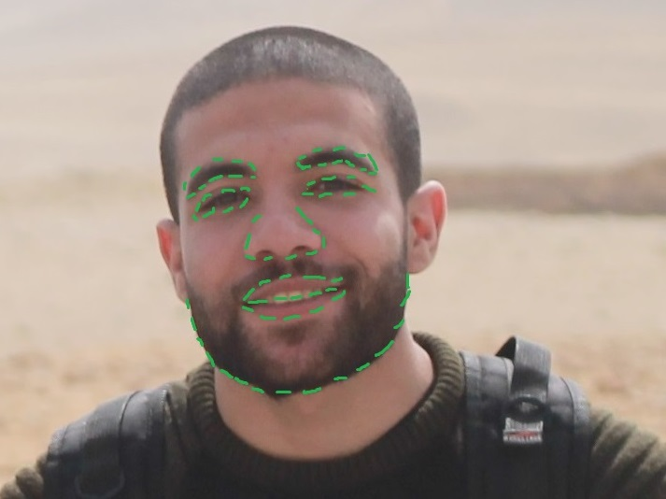
Face Recognition
WHY ?
WHAT ?
Implementation ?
How works ?
2-Face image classification and decision making (Features extraction)
All facial-scan systems attempt to match visible facial features in a fashion similar to the way people recognize one another.
The features most often utilized in facial-scan systems are those least likely to change significantly over time:
Upper ridges of the eye sockets
Areas around the cheekbones
Sides of the mouth
Nose shape
The position of major features relative to each other.

Slide 11
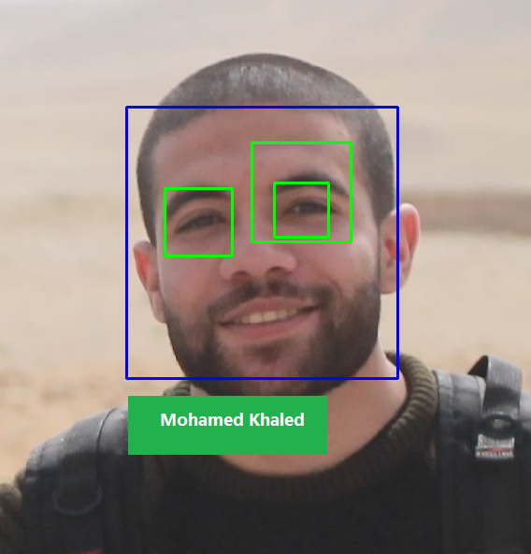
Face Recognition
WHY ?
WHAT ?
Implementation ?
How works ?
3-Computer vision (Face Recognition)
Images are cropped and colour images are normally converted to black and white image (Binary image) in order to facilitate initial comparisons based on gray scale characteristic
First, The presence of faces of the students in the class must be detected.
Once the face is detected, it must be localized and normalization process may be required to bring the dimensions of the live facial sample in alignment with the one on the template

Slide 12
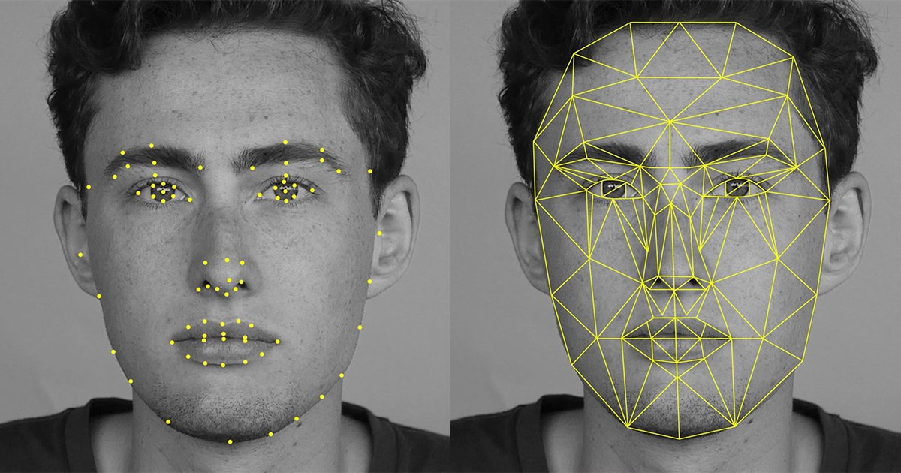
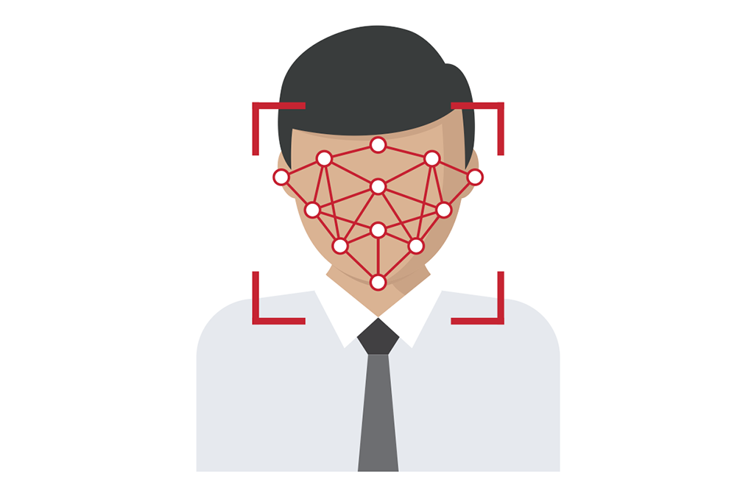
Face Recognition
WHY ?
WHAT ?
Implementation ?
How works ?
HOW Facial Recognition works?
Every face has at least 80 distinguishable parts called nodal points.
Here are few nodal points below :
Distance between the eyes
Depth of eye sockets
Width of the nose
Length of jaw line
Structure of the cheekbone

Slide 13

Solution
We are going to make a desktop application
We can implement it in Matlab or Python
MATLAB or Python has some advantages for image processing:
The ability to call external libraries, such as OpenCV
A very large database of built-in algorithms for image processing and computer vision applications.
A large user community with lots of free code and knowledge sharing
There is desktop environment which allows you to work interactively with our data, files, variables and simplifies common programming/debugging tasks

Slide 14
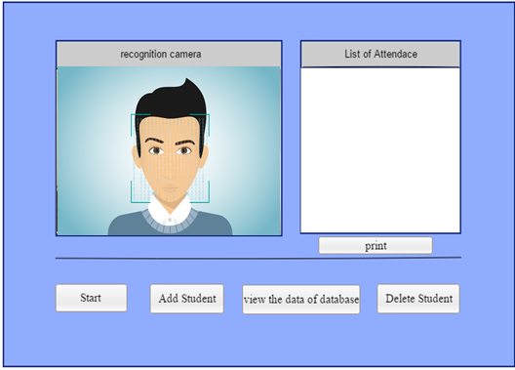
Prototype
Add new student
Delete an student
Print Attendance
When the user want to add a new student in the database
Add student Form:
Enter The name of this student:
The Student Added Successfully .!!!
Abubakr Hussein
Add
Click here

Slide 15
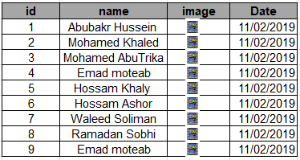
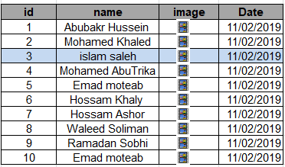
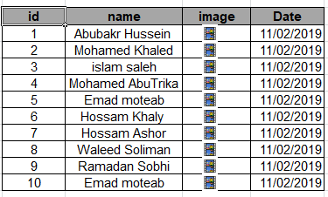
Prototype
Delete an Student
Print Attendance
Add new student
When the user want to add a new student in the database
Click here
Click here

Slide 16
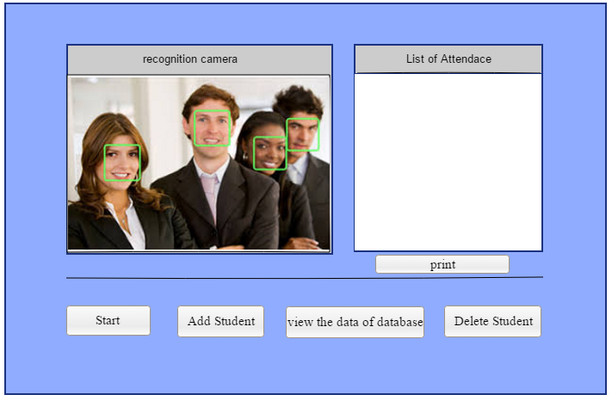
Prototype
Add new student
Delete an student
Print Attendance
When the user want to print the attendance
1:Abubakr Hussein
2:Mohamed Khaled
3:Sara Ali
4: Rania Mahomud
Click here
Click here

Slide 17
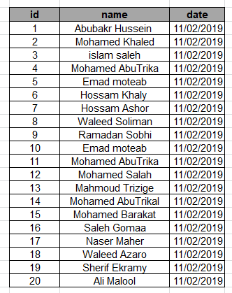
Prototype
Add new student
Delete an student
Print Attendance
Attendance Excel Sheet

Slide 18
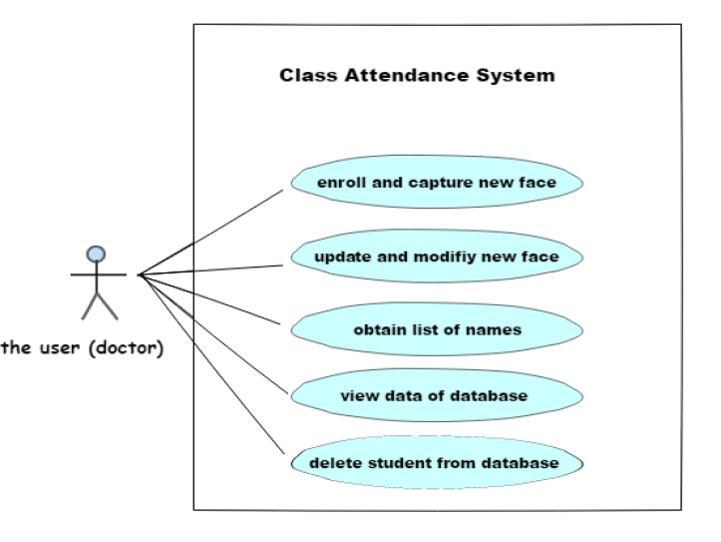
Software Design
Use case
Sequence diagrams
Class diagram
ERD
Database
Class attendance system

Slide 19
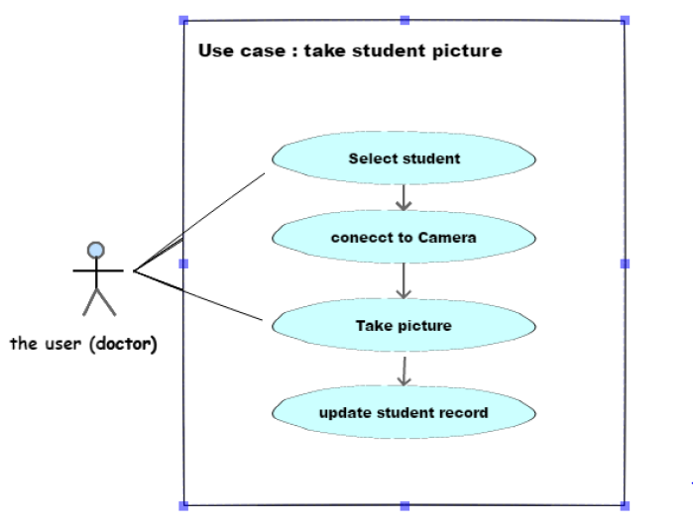
Software Design
Use case
Sequence diagrams
Class diagram
ERD
Database
Capture new image

Slide 20
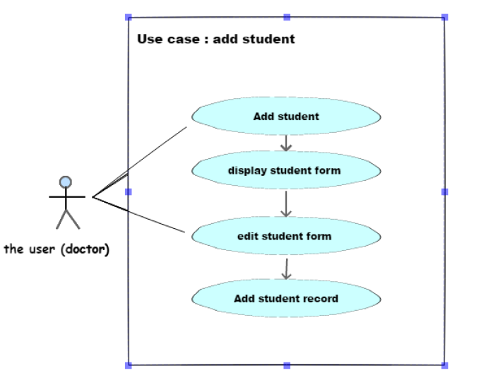
Software Design
Use case
Sequence diagrams
Class diagram
ERD
Database
Add student

Slide 21
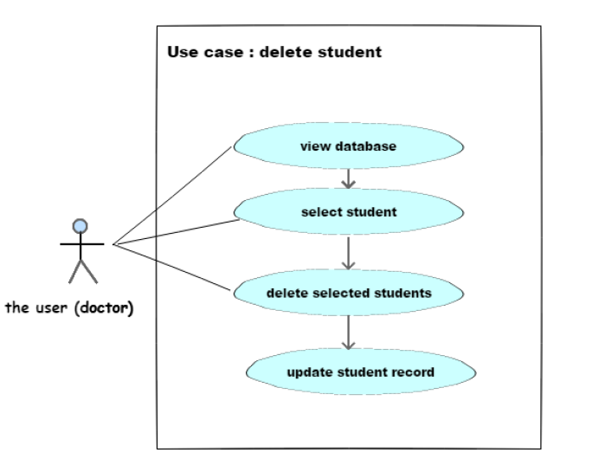
Software Design
Use case
Sequence diagrams
Class diagram
ERD
Database
Delete student

Slide 22
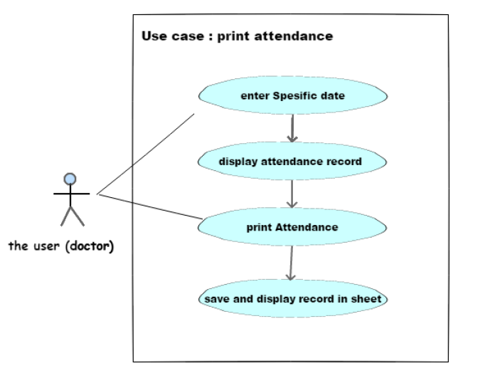
Software Design
Use case
Sequence diagrams
Class diagram
ERD
Database
Print attendance

Slide 23
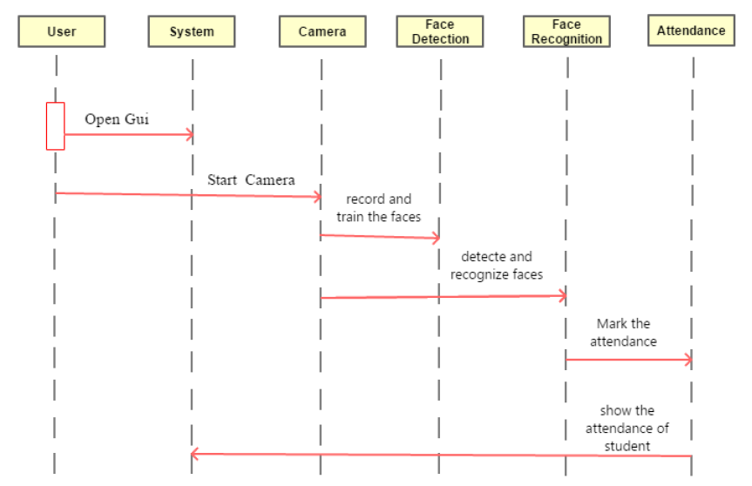
Software Design
Use case
Sequence diagrams
Class diagram
ERD
Database
Sequence diagrams

Slide 24
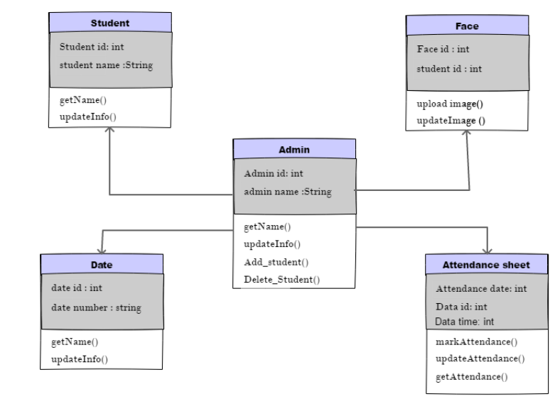
Software Design
Use case
Sequence diagrams
Class diagram
ERD
Database
Class diagram

Slide 25
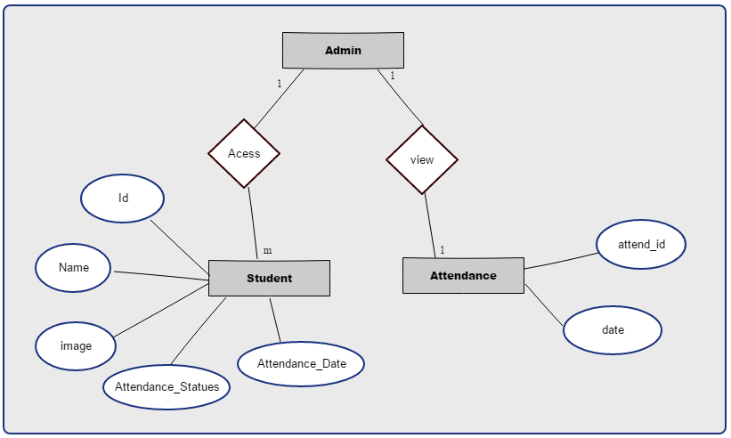
Software Design
Use case
Sequence diagrams
Class diagram
ERD
Database
Entity Relationship Diagram (ERD)

Slide 26
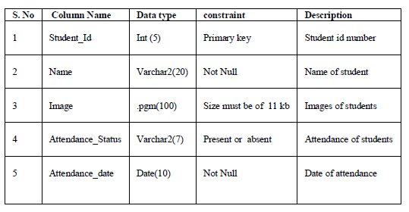
Software Design
Use case
Sequence diagrams
Class diagram
ERD
Database
Database:
TableName: Student

Slide 27
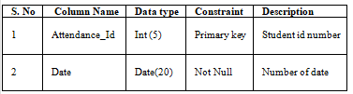
Software Design
Use case
Sequence diagrams
Class diagram
ERD
Database
Database:
TableName: Attendance

Slide 28
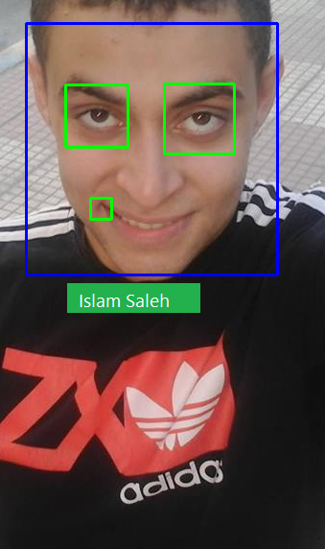
Results and conclusion
A general face recognition software conducts a comparison of these parameters to the images in its database. Depending upon the matches found, it determines the result.
This technique is known as feature based matching and it is the most basic method of facial recognition.

Slide 29
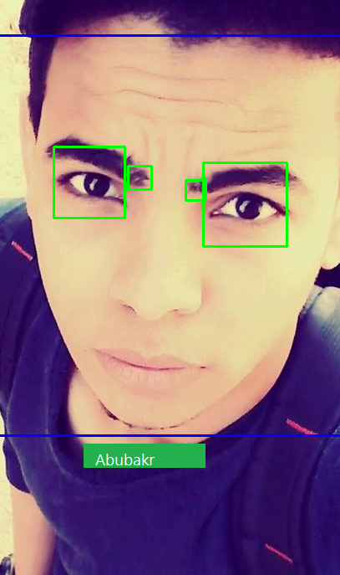
Result

Slide 30
Thanks

